Slide 1
Pulse Modulation

Slide 2
Content
Introduction of Pulse Modulation
Sampling Process
PAM – Pulse Amplitude Modulation
PPM – pulse Position Modulation
Quantization
PCM – Pulse Code Modulation
Delta Modulation
Differential PCM
Line Codes

Slide 3
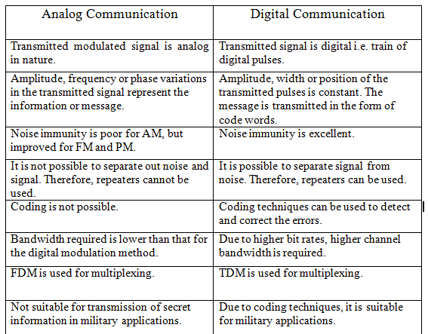
Why digital modulation ?
Digital Modulation provides more information capacity, high data security, quicker system availability with great quality communication.
Hence, digital modulation techniques have a greater demand, for their capacity to convey larger amounts of data than analog modulation techniques.

Slide 4
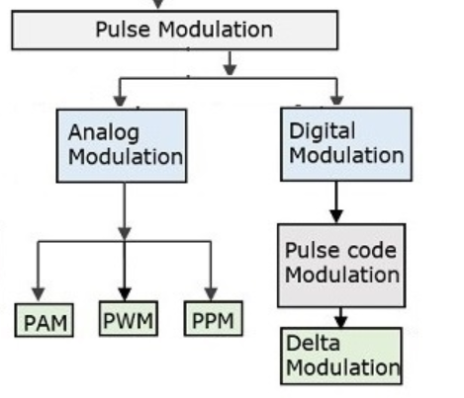
Introduction of Pulse Modulation
In Continues Wave (CW) Modulation some parameters of a Sinusoidal carrier wave is varied continuously in accordance with the (amplitude of) massage Signal.
In Pulse Modulation some parameters of the Pulse Train is varied in accordance with the massage Signal.
We may distinguish two families of the pulse modulation.

Slide 5
In analog Pulse Modulation, Periodic Pulse Train is used as the carrier wave and some characteristic features of pulse (Amplitude, duration or position) is varied in a continues manner in accordance with the corresponding sample value of the massage signal.
Thus, in analog pulse modulation information is transmitted basically in analog form, but the transmission take places at discrete times.
In digital pulse modulation the massage signal is represented in a form that is discrete in both Time and Amplitude, there by permitting its transmission in digital form as a sequence of coded pulses.
As a beginning we will discuss the Sampling process, which is basic to all pulse Modulation Systems.

Slide 6
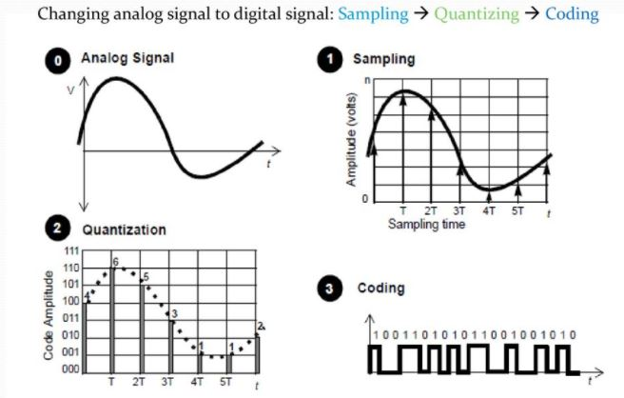
Steps of Analog to Digital Conversion

Slide 7
Sampling process
Sampling process is a basic Operation in the Digital Communication.
In this process Continues time, Analog signal is sampled by measuring its Amplitude at discrete instances.
So, the continues-time Analog Signal is converted into a corresponding sequence of samples that are usually spaced uniformly in time.
It is necessary to choose the sampling rate properly, so the sequence of samples uniquely define the original Analog Signal.

Slide 8

Sampling Rate/frequency
To discretize the signals, the gap between the samples should be fixed. That gap can be termed as a sampling period T_{s}.
Where,
Ts - is the sampling time
Fs - is the sampling frequency or the sampling rate
Sampling frequency is the reciprocal of the sampling period. This sampling frequency, can be simply called as Sampling rate. The sampling rate denotes the number of samples taken per second, or for a finite set of values.

Slide 9

Nyquist Rate
Suppose that a signal is band-limited with no frequency components higher than W Hertz. That means, W is the highest frequency. For such a signal, for effective reproduction of the original signal, the sampling rate should be twice the highest frequency.
Which means,
Where,
fs - is the sampling rate
W - is the highest frequency
This rate of sampling is called as Nyquist rate.
A theorem called, Sampling Theorem, was stated on the theory of this Nyquist rate.

Slide 10
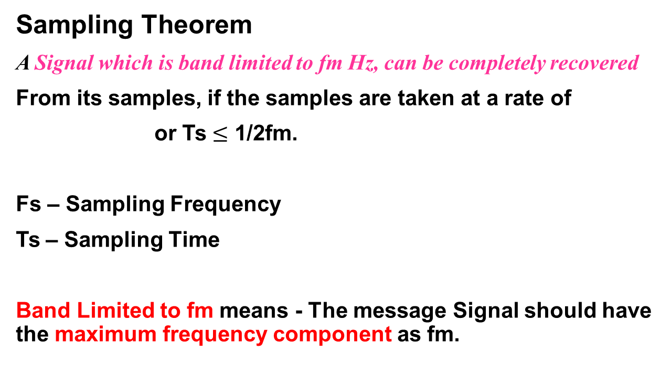
Sampling Theorem
A Signal which is band limited to fm Hz, can be completely recovered
From its samples, if the samples are taken at a rate of
or Ts $≤$ 1/2fm.
Fs – Sampling Frequency
Ts – Sampling Time
Band Limited to fm means - The message Signal should have the maximum frequency component as fm.

Slide 11
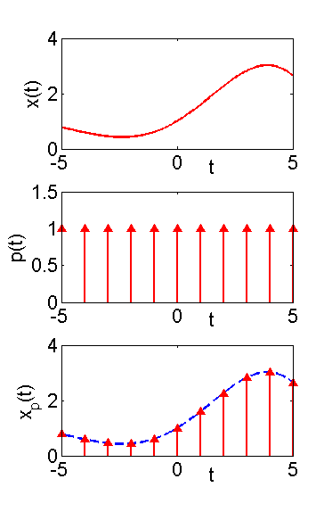
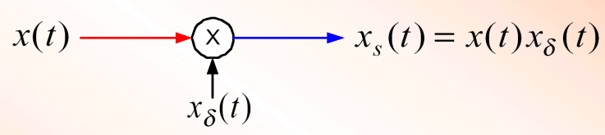
To perform the Sampling process, the message signal is multiplied (By a multiplier) with the Sampling function (Impulse Train).
x(t) - is the band limited message signal
The Sampling function - p(t) is a train of impulses which has time intervals of Ts.
Xp(t) – is sampled Signal
Xp(t)
p(t)
p(t)
Xp(t)
-3Ts
-2Ts
-Ts
Ts
2Ts
3Ts
p(t)

Slide 12
So the sampled signal is a product of message signal and a set of impulse trains
  T =Ts is the sampling period
  ω_{s}=2π/T is the sampling frequency
  This is known as impulse train sampling
  By Definition :

Slide 13


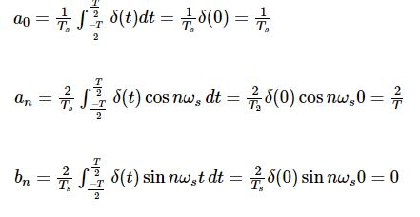
Proof of Sampling Theorem
Consider a continuous time signal x(t). The spectrum of x(t) is a band limited to f_{m} Hz i.e. the spectrum of x(t) is zero for |ω|>ω_{m.}
Sampling of input signal x(t) can be obtained by multiplying x(t) with an impulse train δ(t) of period T_{s}. And let the Sampled Signal as y(t):
Sampled Signal y(t):
The trigonometric Fourier series representation of δ(t) is given by:
Where:

Slide 14

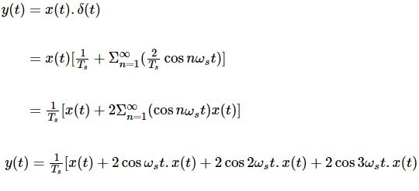
Substitute above values to impulse Terrain:
Substitute δ(t) in y(t) :

Slide 15
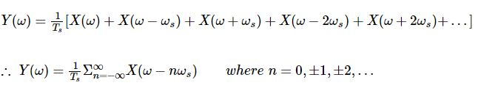
Take Fourier transform on both sides.
To reconstruct x(t), you must recover input signal spectrum X(ω) from sampled signal spectrum Y(ω), which is possible when there is no overlapping between the cycles of Y(ω).

Slide 16
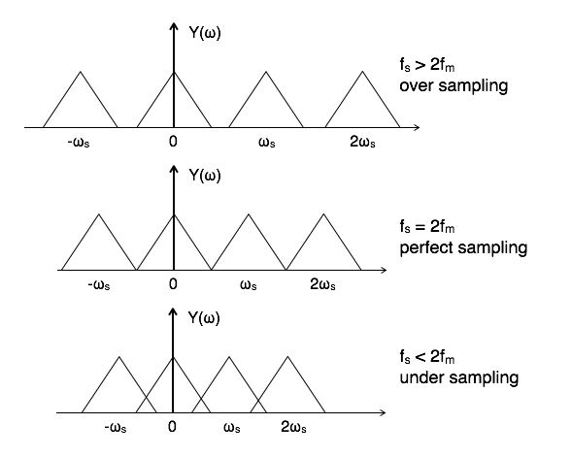
Possibility of sampled frequency spectrum with different conditions is given by the following diagrams:

Slide 17
In Over Sampling , the Original Signal can be extracted using practical law pass filter which having cut off frequency of fm.
In perfect Sampling , the Original Signal can be extracted using Ideal law pass filter which having cut off frequency of fm.
In Under Sampling, the aliasing effect will be occurred and a part of spectrum will be distorted.
Aliasing Effect
The overlapped region in case of under sampling represents Aliasing effect. It can be termed as “the phenomenon of a high-frequency component in the spectrum of a signal, taking on the identity of a lower-frequency component in the spectrum of its sampled version.
This effect can be removed by considering
(i) fs >2fm or
(ii) by using anti aliasing filters which are low pass filters and eliminate high frequency components

Slide 18
Ideal or Impulse sampling
Obtained by multiplying input signal x(t) with impulse train of period 'Ts. Also called ideal sampling.
We have already discussed this topic.
This is called ideal sampling or impulse sampling. You cannot use this practically because pulse width cannot be zero and the generation of impulse train is not possible practically.

Slide 19
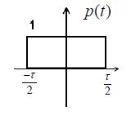

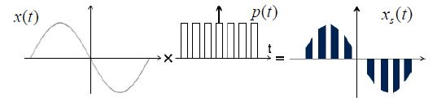
Natural sampling
Natural sampling is similar to impulse sampling, except the impulse train is replaced by pulse train of period Ts. i.e.
The pulse equation is being given as:
With the help of functional diagram of a Natural sampler, a sampled signal xs(t) is obtained by multiplication of Pulse train P(t) and the input signal x(t)
:

Slide 20
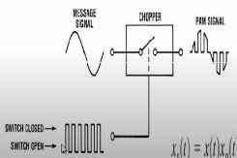

Functional Diagram of Natural Sampler:
When Pulse Train is in high state the switch will be closed.
When Pulse Train is in Law state the switch will be Open.
Pulse train can be viewed as an opening and closing switch.
Practically it is impossible to obtain sampling function with pulse width approaching to Zero.
In natural Sampling a pulse, with finite width is used as a sampling function and Top of the each pulse of the Sampled Signal retain the shape of its corresponding analog segment during the pulse interval.

Slide 21
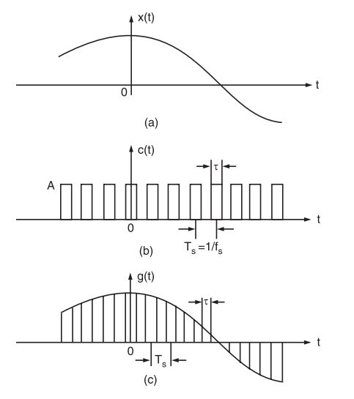
The waveforms of signals x(t), c(t) and g(t) have been illustrated in fig.3(a), (b) and (c) respectively.
(a) Continuous time signal x(t), (b) Sampling function waveform i.e., periodic pulse train, (c) Naturally sampled signal waveform g(t).

Slide 22


Now, the sampled signal g(t) may also be described mathematically as
g(t) = c(t) . x(t)
We can obtain g(t) value as:
Spectrum of naturally sampled signal

Slide 23
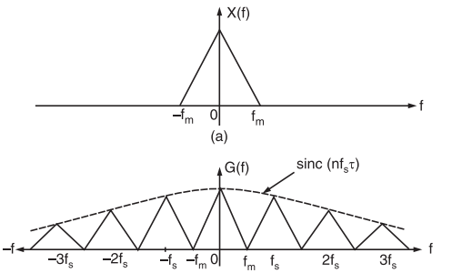
This equation shows that the spectra of x(t) i.e., X(f) are periodic in f_{s} and are weighed by the sinc function.
Figure illustrates some arbitrary spectra for x(t) and corresponding spectrum G(f).

Slide 24
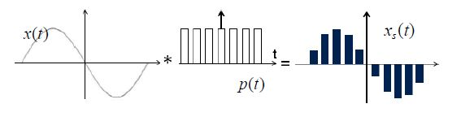
Flat Top Sampling
During transmission, noise is introduced at top of the transmission pulse which can be easily removed if the pulse is in the form of flat top.
Here, the top of the samples are flat i.e. they have constant amplitude. Hence, it is called as flat top sampling or practical sampling.

Slide 25
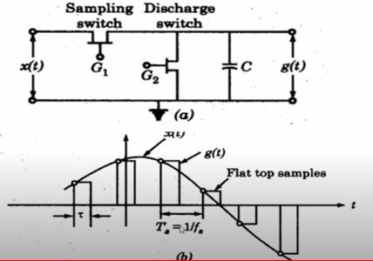
Sample and hold circuit is used for the generation of the sampled signal to attain flat top sampling, which is shown in the Fig below.
Above Sample and hold circuit to generate flat top samples
The switch G1 closes at each sampling instant to sample the modulating signal.
The capacitor C holds the sampled voltage (Starting value of the massage Signal) for period , at the end of which switch G2 is closed in order to discharge the capacitor.

Slide 26
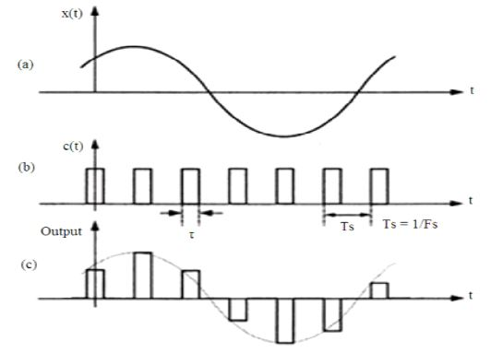
Thus the signal generated as a result of sample and hold process is the flat top sampled signal. The spectrum of the generated flat top sampling signal along with the modulating signal and the sampling signal is shown below figure.

Slide 27

In above Fig (a) Modulating signal (b) sampling signal and (c) Flat top sampling spectrum
The starting edge of the pulse corresponds to the instantaneous value of the modulating signal x(t).
Flat top sampling is mostly used in digital transmission.

Slide 28
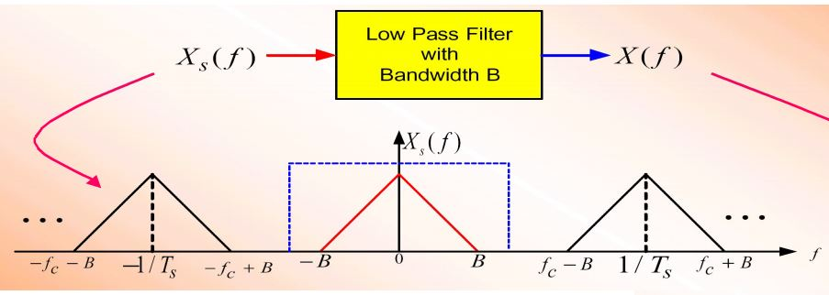
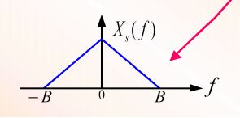
Recovering the Analog Signal One way of recovering the original signal from sampled signal Filter (LPF) as shown below
If fm>2B then we recover x(t) exactly.
Else we run into some problems and signal is not fully recovered.

Slide 29
Pulse Amplitude Modulation
In the PAM systems the width and the timing of the pulse is maintained constant, but the Amplitude of each pulse is varied in accordance with instantaneous value of the analog signal.
Sampling theorem provides us the basis to convert analog signal to discrete time.
The signal is sampled at regular intervals such that each sample is proportional to the amplitude of the signal at that sampling instant.
Sampling can be performed with the help of sampler.
Depending upon different types of sampling techniques we have different types of samplers:
Impulse sampler
Natural sampler
Flat Top sampler

Slide 30
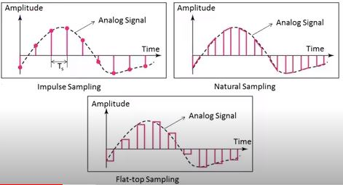
Impulse sampling is not used for information exchange as it has very law power.
Flat Top sampling is most widely used due to its noise mitigation capability.

Slide 31
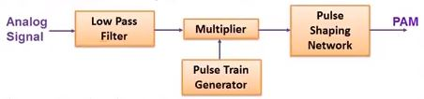
Pulse Amplitude Modulator – Flat Top Sampled
The message signal is passed to the LPF in order to make it band limited whose cutoff frequency is fm. The LPF is used to avoid aliasing effect.
This band limited signal is then sampled at the multiplier with the help of pulse train generator sampled at Ts sec.
It is then passed through a pulse shaping network which produces flat top sampled pulses.

Slide 32
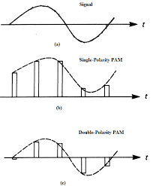
PAM could be:
(i) Single polarity PAM: A suitable fixed DC bias is added to the signal to ensure that all the pulse are positive.
(ii) Double polarity PAM: In this the pulses are both positive and negative.

Slide 33
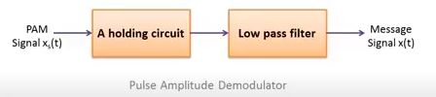
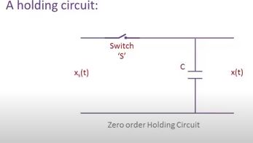
RECEPTION OF PAM SIGNAL
Figure shows the system for recovering message signal x(t) from PAM signal Xs(t).
The PAM Signal is passed through the holding circuit and then with a law pass filter.

Slide 34
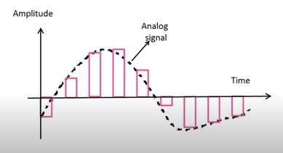
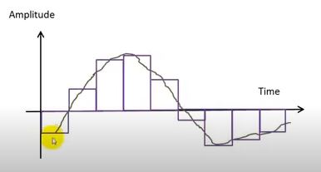
The switch ‘S’ is closed after the arrival of the pulse and it is opened at the end of pulse.
Hence the capacitor ‘C’ is charged to the pulse amplitude value and hold this value till the next pulse arrives.
After that the signal is smoothened by a LPF in order to get the message signal back.

Slide 35
Transmission of PAM signals
For PAM signals to be transmitted through space using antennas, they must be amplitude/frequency/ phase modulated by a high frequency carrier and only then they can be transmitted.
Thus the overall system is PAM-AM. PAM-FM or PAM-PM and at receiving end, AM/ FM/PM detection is first employed to get the PAM signal and then message signal is recovered.
Transmission BW of PAM Signal
In Pulse amplitude modulated signal the pulse duration  is considered to be very small in comparison to time period(Sampling period) Ts between any two samples.
 << Ts
Now, if the maximum frequency of the modulating signal x(t) is fm, then according to the sampling theorem the sampling frequency fs must be greater than or equal to the Nyquist rate that is :

Slide 36



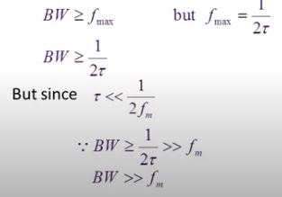
We can get as;
But as per the assumption:
If we consider the ‘ON’ and ‘OFF’ time of PAM signal is same, then the maximum frequency of PAM will be:
The Bandwidth required for the transmission of a PAM signal would be equal to the maximum frequency fmax is given by:

Slide 37
Drawbacks of PAM
Bandwidth required for transmission of PAM signal is very large in comparison to maximum frequency present in modulating signal.
Since amplitude of PAM pulses varies in accordance with modulating signal so interference of noise is maximum.
Since amplitude of PAM pulses varies In PAM Variation of the peak power required by transmitter.
Demodulation of PAM
PAM signal sampled at Nyquist rate can be reconstructed at the receiver end , by passing it through an efficient Low Pass Filter (LPF) with exact cut off frequency of fs/2. This is known as Reconstruction or Interpolation Filter.
The low pass filter eliminates the high-frequency ripples and generates the demodulated signal. This signal is then applied to the inverting amplifier to amplify its signal level to have the demodulated output with almost equal amplitude with the modulating signal

Slide 38
PULSE WIDTH MODULATION: PWM
Pulse Width Modulation (PWM) / Pulse Duration Modulation (PDM) / Pulse Time Modulation (PTM) is an analog modulating scheme in which the width or duration or time of the pulse carrier varies proportional to the instantaneous amplitude of the message signal.
The width of the pulse varies in this method, but the amplitude of the (Pulse Train) signal remains constant. Amplitude limiters are used to make the amplitude of the signal constant. These circuits clip off the amplitude, to a desired level and hence the noise is limited.

Slide 39
Pulse-width modulation (PWM), or pulse-duration modulation (PDM), is a method of reducing the average power delivered by an electrical signal, by effectively chopping it up into discrete parts.
The average value of voltage (and current) fed to the load is controlled by turning the switch between supply and load on and off at a fast rate.

Slide 40
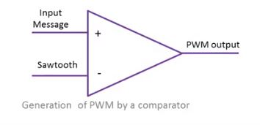
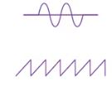
Generation of PWM by a Comparator
When this method is used to generate PWM, the peak value of the message signal should be less than the peak value of the Sawtooth wave form.

Slide 41
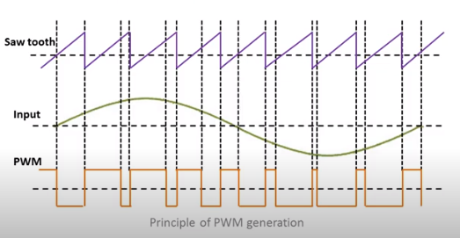
The Comparator produces the output depending upon the inputs (Message Signal) applied. Ex High(+ve) or law (-ve)
It produces the +ve or –ve pulses depending upon the magnitude of the message signal and the Saw-Tooth Pulses.
The Width of the pulse is dependent on the amplitude of the message Signal.
When The Input voltage is lesser than the Sawtooth voltage then the Out Put Pulse will be Negative and Vise versa.

Slide 42
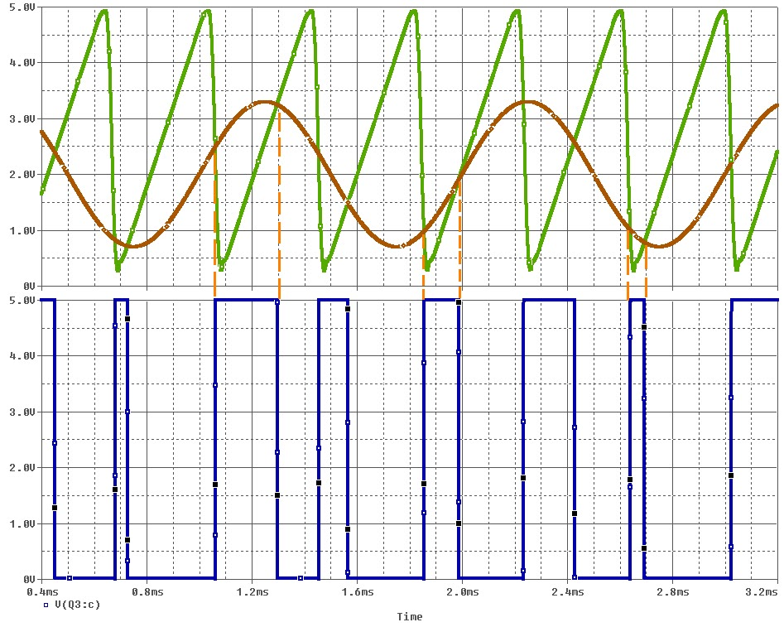

Slide 43
Duty Cycle
Definition: The Duty Cycle is a measure of the time the modulated signal is in its “high” state.
It is generally recorded as the percentage of the signal period where the signal is considered on.
The term duty cycle describes the proportion of 'on' time to the regular interval or 'period' of time; a low duty cycle corresponds to low power, because the power is off for most of the time.
On
Off
VH
Duty Cycle (D)
VL
Period (T)

Slide 44
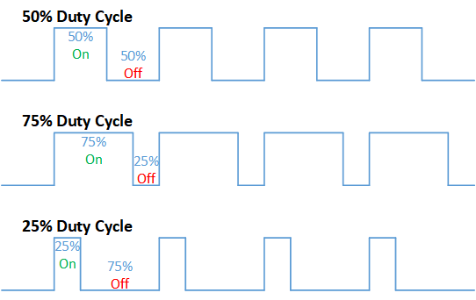
Duty Cycle Formulation
Duty Cycle is determined by:
On
Off
VH
Duty Cycle (D)
VL
Period (T)

Slide 45
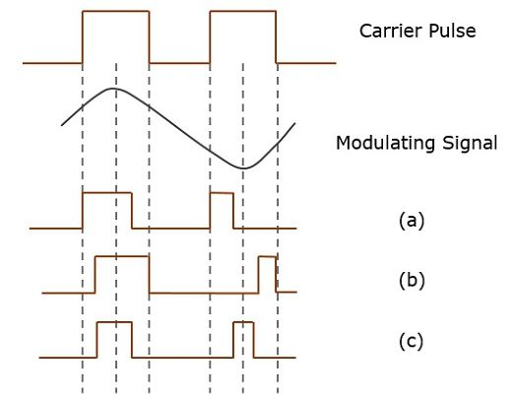
The following figures explain the types of Pulse Width Modulations.

Slide 46
There are three variations of PWM. They are −
(a) The leading edge of the pulse being constant, the trailing edge varies according to the message signal.
(b) The trailing edge of the pulse being constant, the leading edge varies according to the message signal.
(c) The center of the pulse being constant, the leading edge and the trailing edge varies according to the message signal.
These three types are shown in the above given figure, with timing slots.

Slide 47
Pulse Position Modulation - ppm
Pulse Position Modulation (PPM) is an analog modulating scheme in which the amplitude and width of the pulses are kept constant, while the position of each pulse, with reference to the position of a reference pulse varies according to the instantaneous sampled value of the message signal.
The transmitter has to send synchronizing pulses (or simply sync pulses) to keep the transmitter and receiver in synchronism. These sync pulses help maintain the position of the pulses. The following figures explain the Pulse Position Modulation.

Slide 48
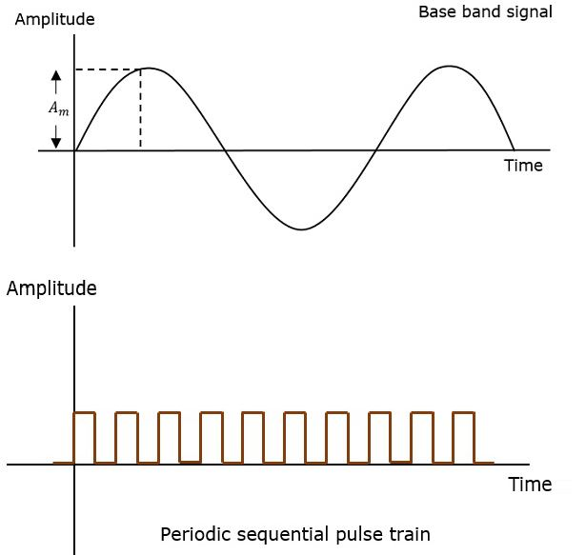
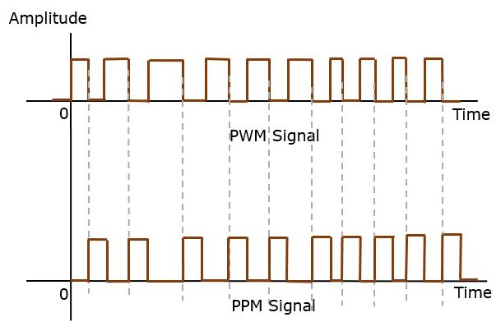

Slide 49

The input to the PPM Generator is a PWM Signal.
The inverter reverse the polarity of the pulses.
As it passes through differentiator we have;
+ve Spikes where original PWM pulse is going from HIGH to LAW.
-Ve spikes where original PWM Pulse is going from law to High.

Slide 50
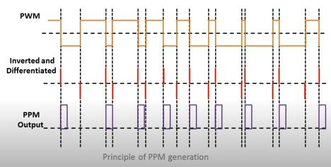
Spikes are fed to a +ve edge triggered fixed width pulse generator.
Generator generates the pulse of fixed width when only a +ve spike appears.
The occurrence of these pulses are dependent on the input message signal, hence the pulses produced is PPM.

Slide 51
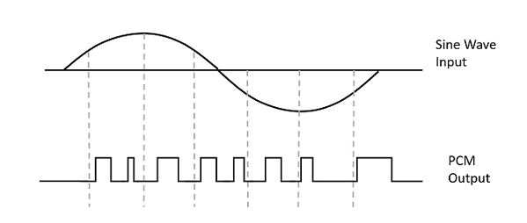
Pulse code modulation
A signal is pulse code modulated to convert its analog information into a binary sequence, i.e., 1s and 0s. The output of a PCM will resemble a binary sequence
The following figure shows an example of PCM output with respect to instantaneous values of a given sine wave

Slide 52
Instead of a pulse train, PCM produces a series of numbers or digits, and hence this process is called as digital. Each one of these digits, though in binary code, represent the approximate amplitude of the signal sample at that instant.
In Pulse Code Modulation, the message signal is represented by a sequence of coded pulses. This message signal is achieved by representing the signal in discrete form in both time and amplitude.

Slide 53
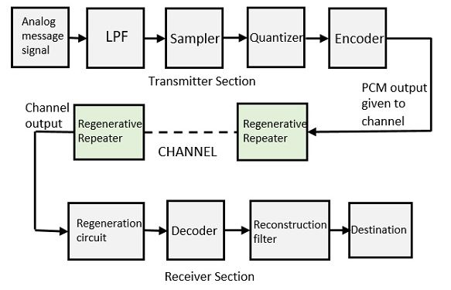
Basic Elements of PCM
The transmitter section of a Pulse Code Modulator circuit consists of Sampling, Quantizing and Encoding, which are performed in the analog-to-digital converter section. The low pass filter prior to sampling prevents aliasing of the message signal.
The basic operations in the receiver section are regeneration of impaired signals, decoding, and reconstruction of the quantized pulse train. Following is the block diagram of PCM which represents the basic elements of both the transmitter and the receiver sections.

Slide 54
Low Pass Filter
This filter eliminates the high frequency components present in the input analog signal which is greater than the highest frequency of the message signal, to avoid aliasing of the message signal.
Sampler
This is the technique which helps to collect the sample data at instantaneous values of message signal, so as to reconstruct the original signal. The sampling rate must be greater than twice the highest frequency component W of the message signal, in accordance with the sampling theorem.
Quantizer
Quantizing is a process of reducing the excessive bits and confining the data. The sampled output when given to Quantizer, reduces the redundant bits and compresses the value.

Slide 55
Encoder
The digitization of analog signal is done by the encoder. It designates each quantized level by a binary code. The sampling done here is the sample-and-hold process. These three sections LPF, Sampler, and Quantizer will act as an analog to digital converter. Encoding minimizes the bandwidth used.
Regenerative Repeater
This section increases the signal strength. The output of the channel also has one regenerative repeater circuit, to compensate the signal loss and reconstruct the signal, and also to increase its strength.

Slide 56
Decoder
The decoder circuit decodes the pulse coded waveform to reproduce the original signal. This circuit acts as the demodulator.
Reconstruction Filter
After the digital-to-analog conversion is done by the regenerative circuit and the decoder, a low-pass filter is employed, called as the reconstruction filter to get back the original signal.
Hence, the Pulse Code Modulator circuit digitizes the given analog signal, codes it and samples it, and then transmits it in an analog form. This whole process is repeated in a reverse pattern to obtain the original signal.

Slide 57
Quantization
The digitization of analog signals involves the rounding off of the values which are approximately equal to the analog values. The method of sampling chooses a few points on the analog signal and then these points are joined to round off the value to a near stabilized value. Such a process is called as Quantization.
Quantizing an Analog Signal
The analog-to-digital converters perform this type of function to create a series of digital values out of the given analog signal. The following figure represents an analog signal. This signal to get converted into digital, has to undergo sampling and quantizing.

Slide 58
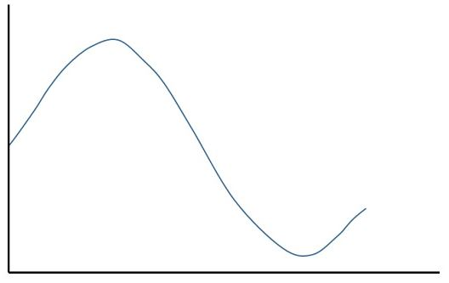
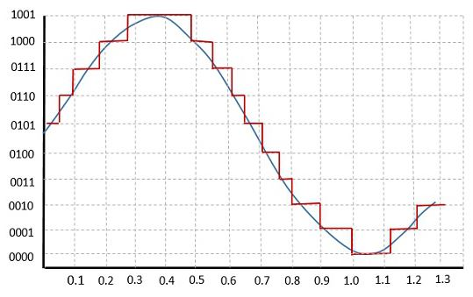
The quantizing of an analog signal is done by discretizing the signal with a number of quantization levels. Quantization is representing the sampled values of the amplitude by a finite set of levels, which means converting a continuous-amplitude sample into a discrete-time signal.
The following figure shows how an analog signal gets quantized. The blue line represents analog signal while the brown one represents the quantized signal.

Slide 59
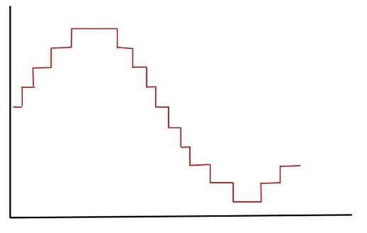
Both sampling and quantization result in the loss of information. The quality of a Quantizer output depends upon the number of quantization levels used. The discrete amplitudes of the quantized output are called as representation levels or reconstruction levels. The spacing between the two adjacent representation levels is called a quantum or step-size.
The following figure shows the resultant quantized signal which is the digital form for the given analog signal.
This is also called as Stair-case waveform, in accordance with its shape

Slide 60




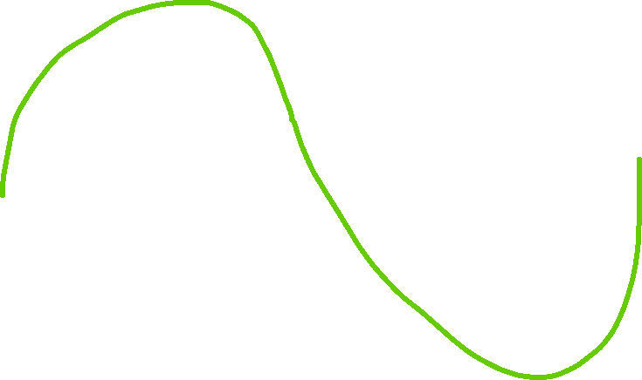


















































Slide 61





















































Slide 62



































Slide 63
































Slide 64














































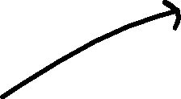






Slide 65











































Slide 66



































Slide 67






























































Slide 68
























































Slide 69



























































Slide 70












































Slide 71


How to perform the quantization?
1. The amplitudes of signal m(t) lie in the range (- m_{p}, m_{p}), which is partitioned into L intervals, each of magnitude Step Size : Δν = 2m_{p}/L.
2. Each sample amplitude is approximated by the midpoint value of the interval in which the sample falls.

Slide 72
The amplitude range: (- m_{p}, m_{p}),
Interval(Step Size ): Δν = 2m_{p}/L
In quantization process, a sampling value is approximated by
the midpoint of the interval. This introduces an error q(t),
defined as the difference between the message signal m(t) and
the corresponding quantized sample m_{q}(t),
q(t) = m(t) – m_{q}(t)
This error is called the quantization noise or quantization error.

Slide 73
Quantization noise
Since q(t) is uniformly distributed over the interval (-Δν/2, Δν/2), i.e., the error has equal probability to lie in the range (-Δν/2, Δν/2), the probability density is then 1/Δν, hence the mean square value of q(t) is given by
Quantization noise power
The quantization noise power is :
The output signal-to-noise ratio is

Slide 74
From above discussion, it is clear that quantization
results in a loss of information.
(Information can also be lost in PAM due to noise)
Such an information lost due to quantization may
be reduced by increasing the number of levels used, L.
e.g. 8 to 16 levels are sufficient for speech communication.

Slide 75
Example:1
The digital audio compact optical disc (CD) system uses 16 bit quantization and a sampling rate of 44.1 kHz per channel.
Assuming the audio signal has a peak to mean power ratio of 13 dB, occupies the frequency band 0 to 20 kHz and that the recovery filter has an effective bandwidth, allowing for the finite cut-off rate of a practical filter of 22 kHz, estimate the signal to quantization noise ratio attainable.

Slide 76
Solution:
f_{s} = 44.1 kHz, n = 16, thus we have L = 2¹⁶ quantization levels.
So we have:

Slide 77
Example: 2
A 12 bit ADC having analog input voltage ranging from -2v to 2 v. Determine followings:
  No of quantization Levels
  Step Size
  Quantization Level, when the analog Voltage is 1.33
  Quantization error (for case I)
  Dynamic Range

Slide 78
Types of Quantization
There are two types of Quantization - Uniform Quantization and Non-uniform Quantization.
The type of quantization in which the quantization levels are uniformly spaced is termed as a Uniform Quantization.
The type of quantization in which the quantization levels are unequal and mostly the relation between them is logarithmic, is termed as a Non-uniform Quantization.
There are two types of uniform quantization. They are Mid-Rise type and Mid-Tread type. The following figures represent the two types of uniform quantization.

Slide 79
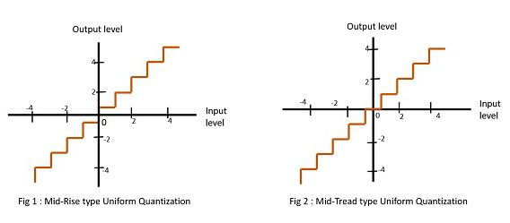
Figure 1 shows the mid-rise type and figure 2 shows the mid-tread type of uniform quantization.
The Mid-Rise type is so called because the origin lies in the middle of a raising part of the stair-case like graph. The quantization levels in this type are even in number.
The Mid-tread type is so called because the origin lies in the middle of a tread of the stair-case like graph. The quantization levels in this type are odd in number.
Both the mid-rise and mid-tread type of uniform quantizers are symmetric about the origin.

Slide 80
Encoding
After sampling and quantization, the analog message signal becomes discrete in values, but it is still not in the form best suited for transmission.
In order that the signal is best suited for transmission, i.e. more robust to noise and interference, an encoding process is required to translate the discrete samples to a more appropriate form, such as the binary digits.

Slide 81
Encoding

Slide 83
